Slide 1
Big Data 101:
Session 2

Slide 2
Week 2 – Topics
Use Cases
The landscape and Marketplace
The Big Data Stack

Slide 3
Use Cases
Use Cases in all verticals
Use Cases across all Verticals

Slide 4
Big Data Use Cases
EDW
Analytics
Modern Data Architectures
Low Cost and Scalable Storage
ETL Offload
Data Warehousing
Master Data Management
Batch Analytics
Ad-Hoc Analytics
Predictive Analytics
Near Real-time Analytics
Operations Serving Platform
Lambda Architectures
Complex Event Processing
Bottom Line Savings
Top Line Growth

Slide 5
Example Vertical Use Cases
INDUSTRY | USE CASE | Sentiment & Web | Clickstream & Behavior | Machine & Sensor | Geographic | Server Logs | Structured & Unstructured
Financial Services | New Account Risk Screens |  |  |  |  | ✔ | ✔
 | Trading Risk |  |  |  |  | ✔
 | Insurance Underwriting |  |  | ✔ | ✔ |  | ✔
Telecom | Call Detail Records (CDR) |  |  | ✔ | ✔
 | Infrastructure Investment |  |  | ✔ |  | ✔
 | Real-time Bandwidth Allocation | ✔ |  |  |  | ✔ | ✔
Retail | 360° View of the Customer |  | ✔ |  |  | ✔ | ✔
 | Localized, Personalized Promotions |  |  |  | ✔
 | Website Optimization |  | ✔
Manufacturing | Supply Chain and Logistics |  |  | ✔
 | Assembly Line Quality Assurance |  |  | ✔
 | Crowd-sourced Quality Assurance | ✔
Healthcare | Use Genomic Data in Medial Trials |  |  | ✔ |  | ✔ | ✔
 | Monitor Patient Vitals in Real-Time
Pharmaceuticals | Recruit and Retain Patients for Drug Trials | ✔ | ✔
 | Improve Prescription Adherence | ✔ |  |  | ✔ | ✔ | ✔
Oil & Gas | Unify Exploration & Production Data |  |  | ✔ | ✔ | ✔ | ✔
 | Monitor Rig Safety in Real-Time |  |  | ✔ |  | ✔ | ✔
Government | ETL Offload/Federal Budgetary Pressures |  |  |  |  | ✔ | ✔
 | Sentiment Analysis for Government Programs | ✔
Notes:
When you distill down all the “new” types of big data that are being managed by Haodop, they generally fall into the six categories .. as represented as columns on the left side of this slide…
- sentiment & web,
- clickstream,
- machine & sensor,
- geographic data,
- server logs and
- and general unstructured content, the stuff we find in docs and pdfs throughout our organization.
Within various vertical, best-practice architectures have emerged to surface the value from Hadoop and HDP. Some representative appear here:
Advertisers target ads to their best customer segment and also analyze point-of-sale data to determine the effectiveness of campaigns.
Banks detect fraud and money laundering while also improving customer service.
Hospitals respond to patients in real time and then analyze historical data to reduce readmission rates.
Manufacturers control quality on the production line and then diagnose product defects in the aggregate.
Oil companies predict and repair equipment proactively and also analyze equipment durability under varied circumstances.
Telecoms allocate bandwidth in real time, and later discover unforeseen patterns after analyzing billions of historical call records.
Retailers make sure the shelves are stocked today and also plan their product mix for next year.
**** WHAT IS YOUR USE CASE???

Slide 6
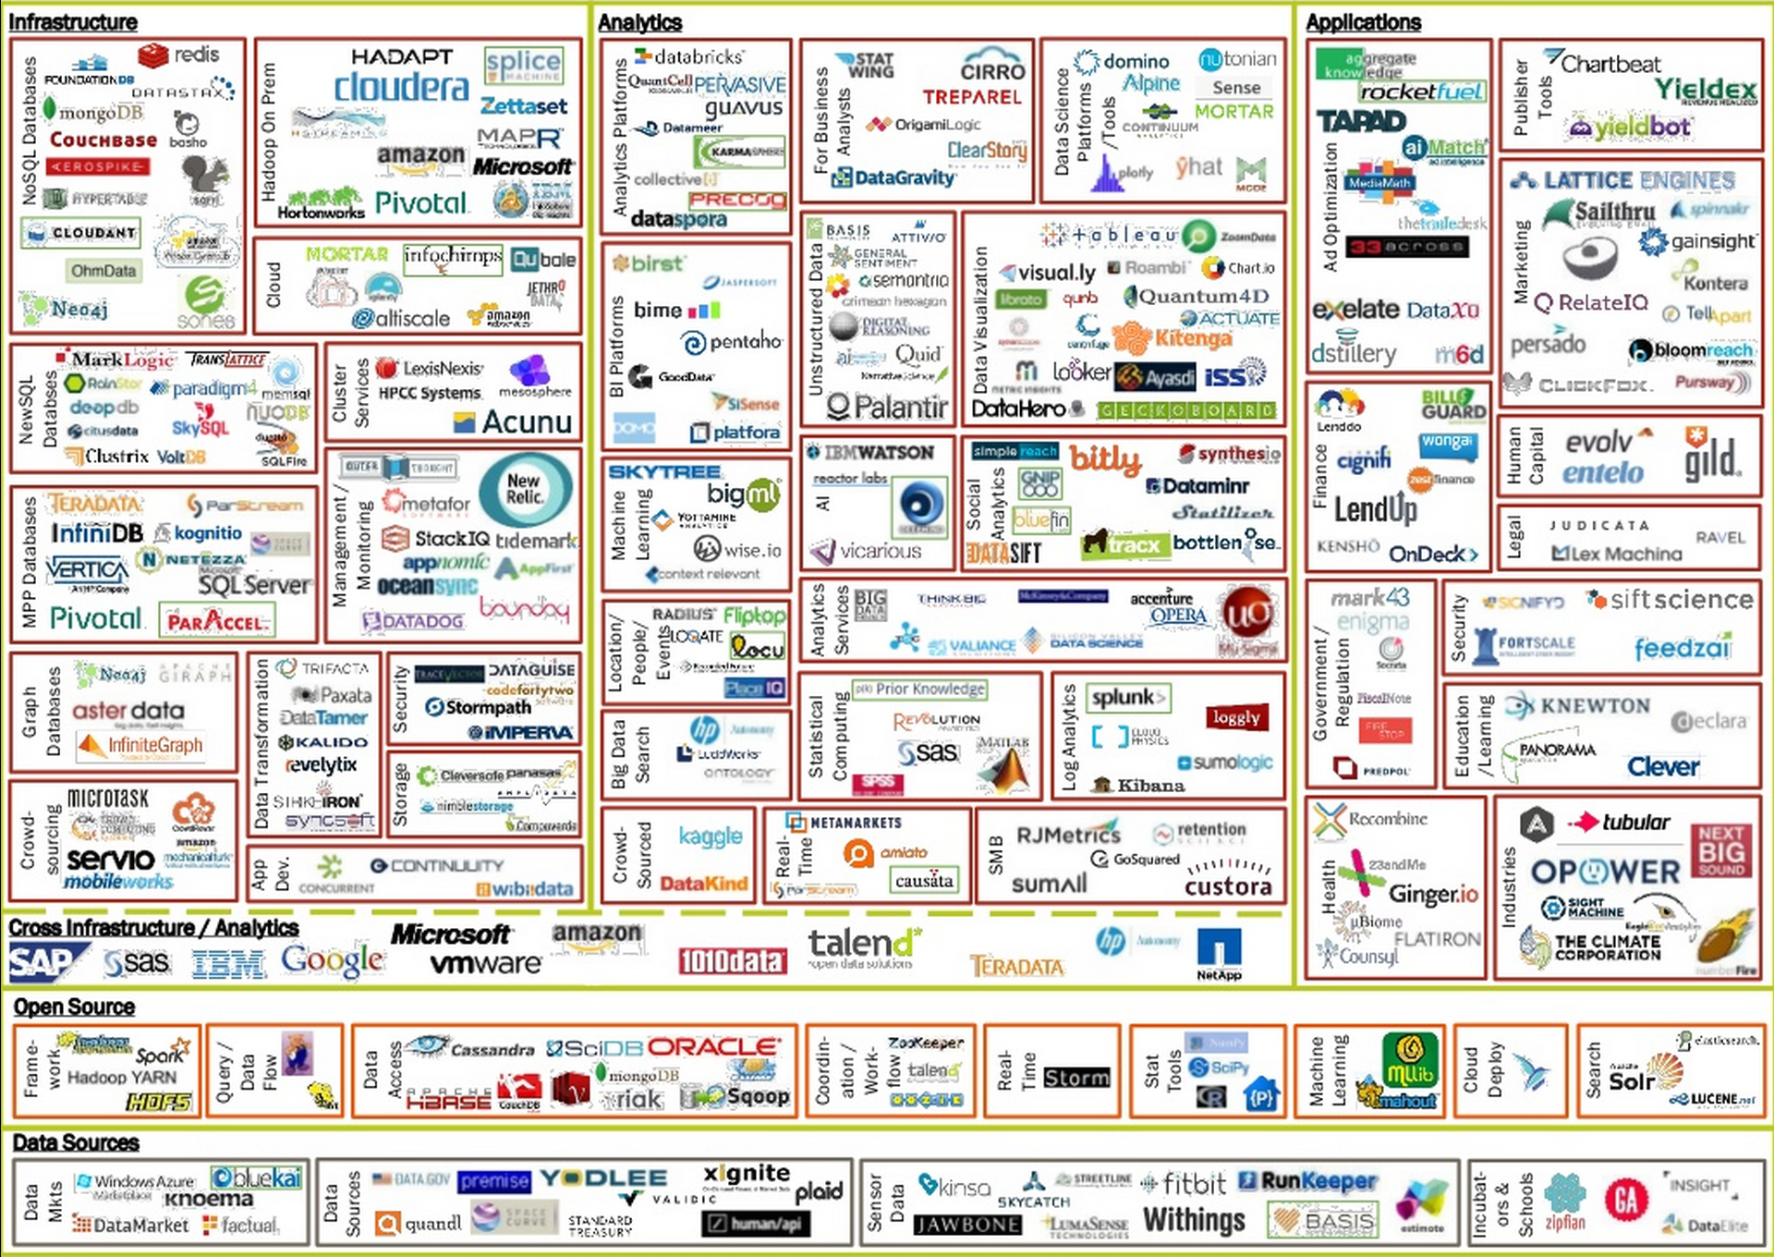
Big Data Landscape ~2014

Slide 7
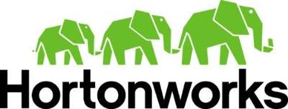










Big Data Platform Players
True Platform
Appliance
Cloud IAAS
Cloud PAAS

Slide 8
Making a Big Data Platform
Given our definition of Big Data / Big Compute
Big Data – You data SIZE is large
Big Compute – Your data or usage COMPLEXITY is high
What do we need from a platform to handle these workloads?
We could:
Scale UP – Get bigger hardware
Scale OUT – Distribute the problem to many small machines
Scaling up is really expensive. Think Big Iron Mainframes
Scaling out is more complex – Distributed Systems

Slide 9
What Makes a Big Data platform
Storage
Resource Management
Processing Coordination and Orchestration
Compute Engines

Slide 10
BATCH ACCESS
Hadoop 1.0
Hive
Pig
Map Reduce
HDFS (Hadoop Distributed File System)
1
°
°
°
°
°
°
°
°
°
°
°
°
°
°
°
°
°
°
°
°
°
°
°
°
°

Slide 11
BATCH, INTERACTIVE & NEAR REAL-TIME DATA ACCESS
Hadoop 2.0 – Towards a Platform
Hive
Pig
Hive
Pig
SQL
Phoenix
Apache
Accumulo
Apache Solr
Apache Storm
Other
Other
Map Reduce
Tez
Spark
hBase
Slider
YARN: Data Operating System
(Cluster Resource Management)
HDFS (Hadoop Distributed File System)
1
°
°
°
°
°
°
°
°
°
°
°
°
°
°
°
°
°
°
°
°
°
°
°
°
°

Slide 12
What Makes a Big Data platform – Part Deux
To make a true Enterprise platform we also need
Data Governance
Security
Cluster Administration
Workflow
Data Ingest

Slide 13
BATCH, INTERACTIVE & NEAR REAL-TIME DATA ACCESS
Adding Governance and Ingest
GOVERNANCE
The formal execution and enforcement of authority over the management of data and related assets.
Hive
Pig
Hive
Pig
SQL
Phoenix
Apache
Accumulo
Apache Solr
Apache Storm
Other
Other
INGEST
Map Reduce
Tez
Spark
hBase
Slider
YARN: Data Operating System
(Cluster Resource Management)
The process of obtaining, importing, and processing data for later use or storage
Batch
Streaming
HDFS (Hadoop Distributed File System)
1
°
°
°
°
°
°
°
°
°
°
°
°
°
°
°
°
°
°
°
°
°
°
°
°
°

Slide 14
BATCH, INTERACTIVE & NEAR REAL-TIME DATA ACCESS
Security
Hortonworks Data Platform 2.2
GOVERNANCE
SECURITY
The formal execution and enforcement of authority over the management of data and related assets.
Hive
Pig
Hive
Pig
SQL
Phoenix
Apache
Accumulo
Apache Solr
Apache Storm
Other
Other
Protective digital measures that are applied to prevent unauthorized access to data.
Authentication
Authorization
Auditing
Administration
INGEST
Map Reduce
Tez
Spark
hBase
Slider
YARN: Data Operating System
(Cluster Resource Management)
The process of obtaining, importing, and processing data for later use or storage
Batch
Streaming
HDFS (Hadoop Distributed File System)
1
°
°
°
°
°
°
°
°
°
°
°
°
°
°
°
°
°
°
°
°
°
°
°
°
°

Slide 15
BATCH, INTERACTIVE & NEAR REAL-TIME DATA ACCESS
Operations and Workflow
Hortonworks Data Platform 2.2
GOVERNANCE
SECURITY
OPERATIONS
The formal execution and enforcement of authority over the management of data and related assets.
Hive
Pig
Hive
Pig
SQL
Phoenix
Apache
Accumulo
Apache Solr
Apache Storm
Other
Other
Protective digital measures that are applied to prevent unauthorized access to data.
Authentication
Authorization
Auditing
Administration
Design, Buildout, maintenance and care of the cluster.
INGEST
Map Reduce
Tez
Spark
hBase
Slider
WORKFLOW
YARN: Data Operating System
(Cluster Resource Management)
The process of obtaining, importing, and processing data for later use or storage
Batch
Streaming
orchestrated and repeatable pattern of business activity enabled by the systematic organization of resources into a processes
HDFS (Hadoop Distributed File System)
1
°
°
°
°
°
°
°
°
°
°
°
°
°
°
°
°
°
°
°
°
°
°
°
°
°

Slide 16
BATCH, INTERACTIVE & NEAR REAL-TIME DATA ACCESS
Platform Example – Hortonworks
Hortonworks Data Platform 2.3
GOVERNANCE
SECURITY
OPERATIONS
Apache Falcon
Apache Atlas
Apache hCatalog
Hive
Pig
Hive
Pig
SQL
Phoenix
Apache
Accumulo
Apache Solr
Apache Storm
Other
Other
Apache Ranger
Apache Knox
Kerberos
HDFS Encryption
Apache Ambari
Apache Cloudbreak
Apache Zookeeper
INGEST
Map Reduce
Tez
Spark
hBase
Slider
WORKFLOW
YARN: Data Operating System
(Cluster Resource Management)
Apache Sqoop
Apache Kafka
Apache Flume
Apache Nifi
HFS Gateway
WebHDFS
Ambari Views
Apache Oozie
Apache Falcon
Apache Zeppelin
HDFS (Hadoop Distributed File System)
1
°
°
°
°
°
°
°
°
°
°
°
°
°
°
°
°
°
°
°
°
°
°
°
°
°

Slide 17
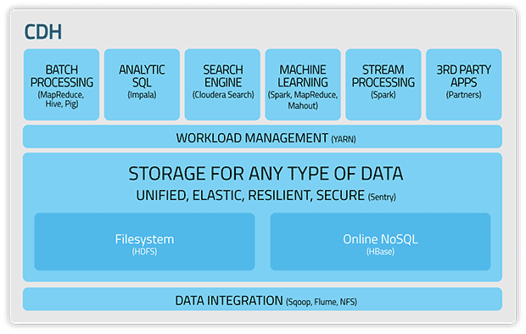
Platform Example – Cloudera

Slide 18
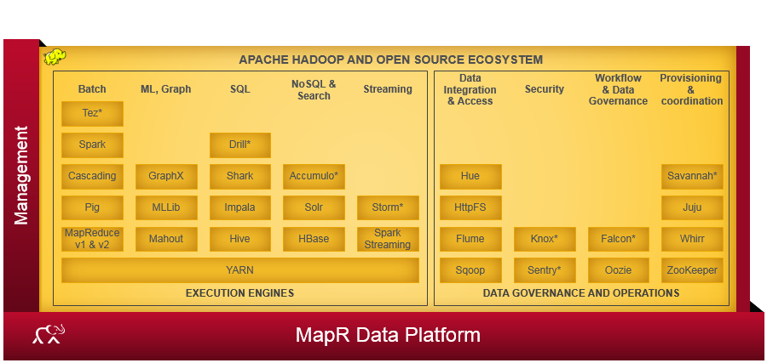
Platform Example – MapR

Slide 19
Platform Example
BATCH, INTERACTIVE & NEAR REAL-TIME DATA ACCESS
Hortonworks Data Platform 2.3
GOVERNANCE
SECURITY
OPERATIONS
Apache Falcon
Apache Atlas
Apache hCatalog
Hive
Pig
Hive
Pig
SQL
Phoenix
Apache
Accumulo
Apache Solr
Apache Storm
Other
Other
Apache Ranger
Apache Knox
Kerberos
HDFS Encryption
Apache Ambari
Apache Cloudbreak
Apache Zookeeper
INGEST
Map Reduce
Tez
Spark
hBase
Slider
WORKFLOW
YARN: Data Operating System
(Cluster Resource Management)
Apache Sqoop
Apache Kafka
Apache Flume
Apache Nifi
HFS Gateway
WebHDFS
Ambari Views
Apache Oozie
Apache Falcon
Apache Zeppelin
HDFS (Hadoop Distributed File System)
1
°
°
°
°
°
°
°
°
°
°
°
°
°
°
°
°
°
°
°
°
°
°
°
°
°

Slide 20
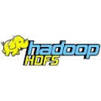

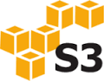
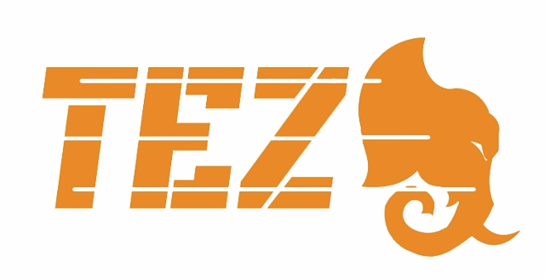




Hadoop Ecosystems At A Glance
Data Storage and Resource Management
Data Engines
HDFS (storage) works closely with MapReduce (data processing) to provide scalable, fault-tolerant, cost-efficient storage for big data.
Map Reduce a programming model and an associated implementation for processing and generating large data sets with a parallel, distributed algorithm on a Hadoop cluster.
S3 (Simple Storage Service) is an online blob storage web service offered by Amazon Web Services.
Tez (SQL) leverages the MapReduce paradigm to enable the execution complex Directed Acyclic Graphs (DAG) of tasks. Tez eliminates unnecessary tasks, synchronization barriers and I/O to HDFS, speeding up data processing.
Azure Blob storage is a service for storing large amounts of unstructured data, such as text or binary data, that can be accessed from anywhere in the world via HTTP or HTTPS.
Spark is an open-source data analytics cluster computing framework Spark provides primitives for in-memory cluster computing that allows user programs to load data into a cluster's memory and query it repeatedly, making it well suited to machine learning algorithms
Mesos is an open-source cluster manager that was developed at the University of California, Berkeley. It "provides efficient resource isolation and sharing across distributed applications, or frameworks"
YARN is the process resource manager and is designed to be co-deployed with HDFS such that there is a single cluster, providing the ability to move the computation resource to the data

Slide 21









Hadoop Ecosystems At A Glance
Data Access
No SQL
Pig (scripting) is a high-level language (Pig Latin) for data analysis programs, and infrastructure for evaluating these programs via map-reduce.
Hbase (NoSQL) Non-relational database that provides random real-time access to data in very large tables. HBase is transactional and allows updates, inserts and deletes. HBase includes support for SQL through Phoenix.
Hive (SQL) Provides data warehouse infrastructure, enabling data summarization, ad-hoc query and analysis of large data sets. The query language, HiveQL (HQL), is similar to SQL.
Accumulo (NoSQL) Based on Google's BigTable design, features a few novel improvements on the BigTable design in the form of cell-based access control
HCatalog (SQL) Table &storage management layer that provides users of Pig, MapReduce and Hive with a relational view of data in HDFS.
Phoenix a SQL skin over HBase delivered as a client-embedded JDBC driver targeting low latency queries over HBase data.
Impala is Cloudera's open source massively parallel processing (MPP) SQL query engine for data stored in a computer cluster running Apache Hadoop.
Cassandra is an open source distributed database management system designed to handle large amounts of data with no single point of failure
Solr is an open source enterprise search platform from the Apache Lucene project. It includes full-text search, hit highlighting, faceted search, dynamic clustering, database integration, and rich document handling. And provides distributed search and index replication.
MongoDB is a cross-platform document-oriented database. Classified as a NoSQL database, MongoDB eschews the traditional table-based relational database structure in favor of JSON-like documents

Slide 22









Hadoop Ecosystems At A Glance
Ingest and Integration
Security
Knox (perimeter security) is a REST gateway for Hadoop providing network isolation, SSO, authentication, authorization and auditing functions.
Kafka is publish-subscribe messaging rethought as a distributed commit log.
Scoop is a tool that efficiently transfers bulk data between Hadoop and structured datastores such as relational databases.
Ranger (security management) is a framework to monitor and manage security assets across a cluster. It provides central administration, monitoring and security hooks for Hadoop applications.
Flume is a distributed service to collect, aggregate and move large amounts of streaming data into HDFS.
Sentry is a system for enforcing fine grained role based authorization to data and metadata stored on a Hadoop cluster. Apache Sentry is currently undergoing Incubation at the Apache Software Foundation.
Storm is a distributed real-time computation system for processing fast, large streams of data. Storm topologies can be written in any programming language.
Nifi is an easy to use, powerful, and reliable system to process and distribute data.
Samza is a distributed stream processing framework. It uses Apache Kafka for messaging, and Apache Hadoop YARN to provide fault tolerance, processor isolation, security, and resource management.

Slide 23





Hadoop Ecosystems At A Glance
Governance
Operations & Management
Falcon is a data governance engine that defines Oozie data pipelines, monitors those pipelines (in coordination with Ambari), and tracks those pipelines for dependencies and audits.
Zookeeper is a distributed configuration and synchronization service and a naming registry for distributed. Distributed applications use Zookeeper to store and mediate updates to
important configuration information.
Atlas is a scalable and extensible set of core foundational governance services – enabling enterprises to effectively and efficiently meet their compliance requirements within Hadoop and allows integration with the whole enterprise data ecosystem.
Oozie (job scheduling) Oozie enables administrators to build complex data transformations, enables greater control over long-running jobs and can schedule repetitions of those jobs.
Ambari (cluster management) is an operational
framework to provision, manage and monitor Hadoop clusters. It includes a web interface for administrators to start/stop/test services and change configurations.
End User Tools
Zeppelin is a web-based notebook that enables interactive data analytics.
Hue (Hadoop Use Experience) Web interface that supports Apache Hadoop and its ecosystem. Hue aggregates the most common Apache Hadoop components into a single interface and targets the user experience.

Slide 24





Hadoop Ecosystems At A Glance
Libraries
File Formats
Avro A data serialization system. Provides, Rich data structures.A compact, fast, binary data format.
A container file, to store persistent data.
Ver: 1.7.4
Mahout is a suite of machine learning libraries designed to be scalable and robust
Ver: 0.9.0
ORC The Optimized Row Columnar (ORC) file format, part of Hive, provides a highly efficient way to store Hive data. It was designed to overcome limitations of the other Hive file formats. Using ORC files improves performance when Hive is reading, writing, and processing data.
Cascading is an application development platform for building Data applications on Apache Hadoop. Ver:
DataFu is a collection of libraries for working with large-scale data in Hadoop. The project was inspired by the need for stable, well-tested libraries for data mining and statistics.
Parquet is a columnar storage format available to any project in the Hadoop ecosystem, regardless of the choice of data processing framework, data model or programming language.
Thrift
Thrift is a data serialization system that allows you to define data types and service interfaces in a simple definition file.

Slide 25
Homework
Form Teams for Course Project
Look around the Sandbox and get comfortable.
Ambari – Port 8080
Hue – Port 8000
Watch the video at: http://www.experfy.com/blog/cloudera-vs-hortonworks-comparing-hadoop-distributions/

Slide 26
Additional Sources
http://www.experfy.com/blog/cloudera-vs-hortonworks-comparing-hadoop-distributions/
http://hortonworks.com/community/forums/
https://community.cloudera.com/
http://blog.cloudera.com/blog/category/use-case/
http://hortonworks.com/developer/
http://www.cloudera.com/content/cloudera/en/developers/home.html
Chapter 4 – Sammer, Eric. Hadoop Operations

